Slide 1
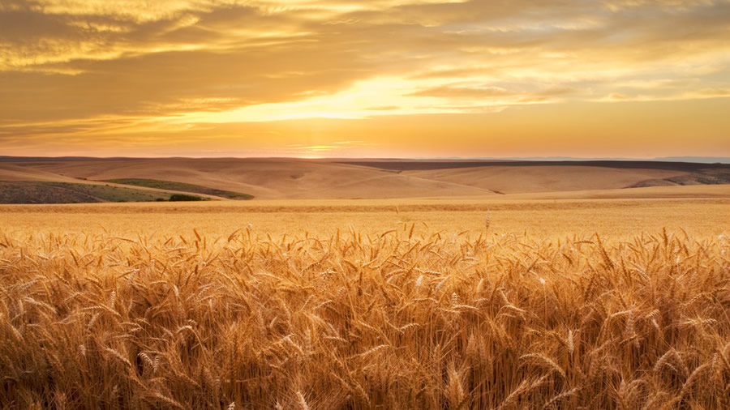
The Gospel of Mark
Traditions and morality
Mark 7:1-23

Slide 2

ICebreaker

Slide 3

Traditions
What traditions do we have in the church (historical or current) that don’t have explicit scriptural backing?
Thinking more broadly, what actions are considered acceptable (or unacceptable) in our community that don’t have explicit scriptural backing?
How can traditions help protect true faith?
How can traditions hurt true faith?
Notes:
Consider some scenarios – (fireworks at the Lord’s supper) Music? Baptism? Dress? Drinking? Order of the service?

Slide 4
Mark 7:1-16
Public questions

Slide 5
Mark 7:1-5 – The Question
1 The Pharisees and some of the scribes who had come from Jerusalem gathered around him. 2 They observed that some of his disciples were eating bread with unclean -- that is, unwashed -- hands. 3 (For the Pharisees and all the Jews do not eat unless they give their hands a ceremonial washing, keeping the tradition of the elders. 4 When they come from the marketplace, they do not eat unless they have washed. And there are many other customs they have received and keep, like the washing of cups, pitchers, kettles, and dining couches.) 5 So the Pharisees and the scribes asked him, "Why don't your disciples live according to the tradition of the elders, instead of eating bread with ceremonially unclean hands? "
Notes:
Describe the scene: A modern occurrence of this would be similar to Jason teaching in front of the church, and someone stands up and openly questions his teaching or the way the service is conducted. Such a public questioning seeks to bring shame on Jesus and questions his competence. Therefore, it demands a response from Jesus.
The narrator clearly identifies the tradition with “all the Jews” indicating to the reader that this tradition is closely tied to being Jewish. The subject of “clean and unclean” is related to fellowship with God. This isn’t an obscure tradition, and while to us, the challenge seems like the subject of ridicule (washing items), it had historical merit. The key to applying this to us today lies in our ability to see similar traditions.

Slide 6
Pharisees and The Jewish Traditions
Exodus 30:19 "Aaron and his sons must wash their hands and feet from the basin. 20 "Whenever they enter the tent of meeting or approach the altar to minister by burning a food offering to the LORD, they must wash with water so that they will not die. 21 "They must wash their hands and feet so that they will not die; this is to be a permanent statute for them, for Aaron and his descendants throughout their generations.“
The pharisees extended the tradition to everyone, and in doing so hoped people would achieve a holiness beyond what was prescribed in the law.
The traditions would have also helped keep the Jewish people separate from the surrounding pagan nations. The physical and obvious action of washing sets the people apart.
The tradition gives everyday acts of life holy significance and helps remind one of God.
Can you find similarity with any of our traditions?
Notes:
Discuss the background of the traditions. The intent of the pharisees was to maintain morality and obedience to the law in Israel. Purity was a key element of their agenda. Jesus disregard for their form of purity would have been appalling to them.
How are these traditions good?
How are they bad?
How do we look similar today?
We celebrate the Lord’s supper in a solemn manner. Why?
We frown (or frowned) upon gambling. Why?
Our church frowns upon leadership drinking. Why?
At one point, we frowned up dancing. Why?
Do we tithe on gross or net?
Think about the divisions that celebrate us as believers.
We say a blessing at meals. Why?

Slide 7
Mark 6:6-16 Jesus goes on the offensive
6 He answered them, "Isaiah prophesied correctly about you hypocrites, as it is written: This people honors me with their lips, but their heart is far from me. 7 "They worship me in vain, teaching as doctrines human commands. 8 "Abandoning the command of God, you hold on to human tradition." 9 He also said to them, "You have a fine way of invalidating God's command in order to set up your tradition! 10 "For Moses said: Honor your father and your mother; and Whoever speaks evil of father or mother must be put to death. 11 "But you say, 'If anyone tells his father or mother: Whatever benefit you might have received from me is corban' " (that is, an offering devoted to God), 12 "you no longer let him do anything for his father or mother. 13 "You nullify the word of God by your tradition that you have handed down. And you do many other similar things.“14 Summoning the crowd again, he told them, "Listen to me, all of you, and understand: 15 "Nothing that goes into a person from outside can defile him but the things that come out of a person are what defile him.“ If anyone has ears to hear, let him hear.
Notes:
“Corban” was a dedication (or vow) setting aside property for God. The vow represented an intention rather than the actual execution.
God commands children to honor their parents. Jewish tradition entailed more than respect requiring children to provide for physical necessities. Children could duck the responsibility by “dedicating” the resources to God rather than using them to help parents.
Jesus point is that honoring parents (a command) supersedes any command to honor vows, and one cannot avoid God’s command through legal loopholes.

Slide 8
Isaiah 29:13 & Tradition of Corban
Isaiah 29:13 13 The Lord says: "These people come near to me with their mouth and honor me with their lips, but their hearts are far from me. Their worship of me is based on merely human rules they have been taught.
“Corban” was a dedication (or vow) setting aside property for God. The vow represented an intention rather than the actual execution.
God commands children to honor their parents. Jewish tradition entailed more than respect requiring children to provide for physical necessities. Children could duck the responsibility by “dedicating” the resources to God rather than using them to help parents.
Jesus’s point is that honoring parents (a command) supersedes any command to honor vows, and one cannot avoid God’s command through legal loopholes. The pharisees tradition had turned the law upside down.

Slide 9
Mark 7:6-13
Jesus private Explanation

Slide 10
Mark 7:17-23
17 When he went into the house away from the crowd, his disciples asked him about the parable. 18 He said to them, "Are you also as lacking in understanding? Don't you realize that nothing going into a person from the outside can defile him? 19 "For it doesn't go into his heart but into the stomach and is eliminated" (thus he declared all foods clean). 20 And he said, "What comes out of a person is what defiles him. 21 "For from within, out of people's hearts, come evil thoughts, sexual immoralities, thefts, murders, 22 "adulteries, greed, evil actions, deceit, self-indulgence, envy, slander, pride, and foolishness. 23 "All these evil things come from within and defile a person."
Actions
Characteristics
Sexual immoralities | Adulteries
Thefts | Greed
Murders | Evil actions
Deceit | Self-indulgence (unbridled lust)
Envy | Slander (evil speaking)
Pride (Arrogance) | Foolishness
Notes:
Jesus extents the teaching beyond hands bringing food into the question. He dismisses the notion that unclean hands defile food. Jesus literally points to the end result of food – literally it goes in one end and out the other – to the latrine.
The bit in parenthesis reads too strong in the translation literally read as “cleansing all foods” the portion “thus he declared” is not found in the text. This isn’t explicitly stating that all foods are clean but rather that they come out clean.
Jesus point is that we need to be concerned with issues of the heart, and not food that eventually comes out and ends up in the latrine.

Slide 11

Application – Traditions and Morality

Slide 12
Traditions: what is the objective?
Do traditions naturally flow from the application of the word of God to real situations in life? (i.e., obedience)?
How can those same traditions hurt us?
What are the consequences if we draw no boundaries at all separating us from secular culture?
How can those same boundaries or traditions create a circle of exclusion that makes it difficult to reach people with the Gospel?
“Tradition is the living faith of the dead, traditionalism is the dead faith of the living.” – Pelikan
“We have clear ideas about what is pure and impure, whether we are fully conscious of them or not.”
Key Lesson: Our religious observance should not clash with common sense and common decency. We must guard against the danger that we become so focused on the details that we miss the grand design.
Notes:
Tradition is like the shell of a blue crab. To live and grow it must shed it’s shell from time to time. Until it creates a new shell, the crab is extremely vulnerable. But if the shell becomes too strong and rigid so that the crab cannot escape, that is the shell it dies in.
Traditions are like the wineskins Jesus mentioned. You need the wineskins or you stand in a puddle of ruined wine. The issue is if the wineskins become old, brittle, and inflexible. Then they no longer achieve their intended purpose.

Slide 13

Morality: what comes out of you?
Actions
Most of us probably feel good about the actions content and check that box.
Where is your heart on the more difficult characteristics.?
Self-Reflection: What comes out of YOU? What is in your heart?
Sexual immoralities | Adulteries
Thefts | Greed
Murders | Evil actions
Characteristics
Deceit | Self-indulgence (unbridled lust)
Envy | Slander (evil speaking)
Pride (Arrogance) | Foolishness
Notes:
Compare the list

Slide 14

Up Next
7/28 Rhett Mark 7:24-37
8/4 Rhett Mark 8:1-26
8/11 Matt Mark 8:27-9:1
8/18 Josh Mark 9:2-13

Slide 15
Selecting visual aids
Enhancing your presentation

Slide 16
Effective delivery techniques
This is a powerful tool in public speaking. It involves varying pitch, tone, and volume to convey emotion, emphasize points, and maintain interest.
Pitch variation
Tone inflection
Volume control
Effective body language enhances your message,
making it more impactful and memorable.
  Meaningful eye contact
  Purposeful gestures
  Maintain good posture
  Control your expressions

Slide 17
Navigating Q&A sessions
Know your material in advance
Anticipate common questions
Rehearse your responses
Maintaining composure during the Q&A session is essential for projecting confidence and authority. Consider the following tips for staying composed:
  Stay calm
  Actively listen
  Pause and reflect
  Maintain eye contact

Slide 18

Speaking impact
Your ability to communicate effectively will leave a lasting impact on your audience
Effectively communicating involves not only delivering a message but also resonating with the experiences, values, and emotions of those listening

Slide 19
Dynamic delivery
Learn to infuse energy into your delivery to leave a lasting impression
One of the goals of effective communication is to motivate your audience
Impact factor | Measurement | Target | Achieved
Audience interaction | Percentage (%) | 85 | 88
Knowledge retention | Percentage (%) | 75 | 80
Post-presentation surveys | Average rating | 4.2 | 4.5
Referral rate | Percentage (%) | 10 | 12
Collaboration opportunities | # of opportunities | 8 | 10

Slide 20
Final tips and takeaways
Consistent rehearsal
  Strengthen your familiarity
Refine delivery style
  Pacing, tone, and emphasis
Timing and transitions
  Aim for seamless, professional delivery
Practice audience
  Enlist colleagues to listen & provide feedback
Seek feedback
Reflect on performance
Explore new techniques
Set personal goals
Iterate and adapt

Slide 21
Speaking engagement metrics
Impact factor | Measurement | Target | Achieved
Audience interaction | Percentage (%) | 85 | 88
Knowledge retention | Percentage (%) | 75 | 80
Post-presentation surveys | Average rating | 4.2 | 4.5
Referral rate | Percentage (%) | 10 | 12
Collaboration opportunities | # of opportunities | 8 | 10

Slide 22

Thank you
Brita Tamm
502-555-0152
brita@firstupconsultants.com
www.firstupconsultants.com

